Slide 1
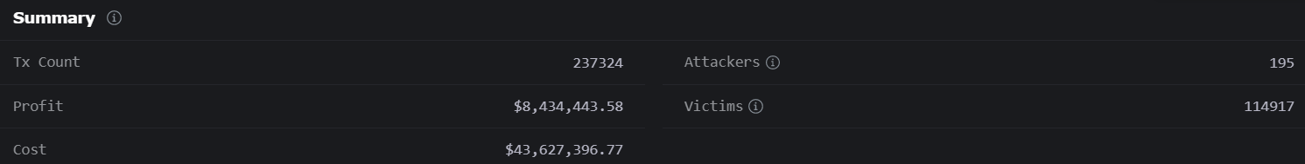
In the past 30 days:
Ending sandwich attacks
195 attackers made 114917 victims
The attackers stole $8,434,443.58
About 3-5 attacks per minute

Slide 2
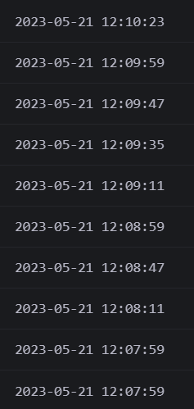
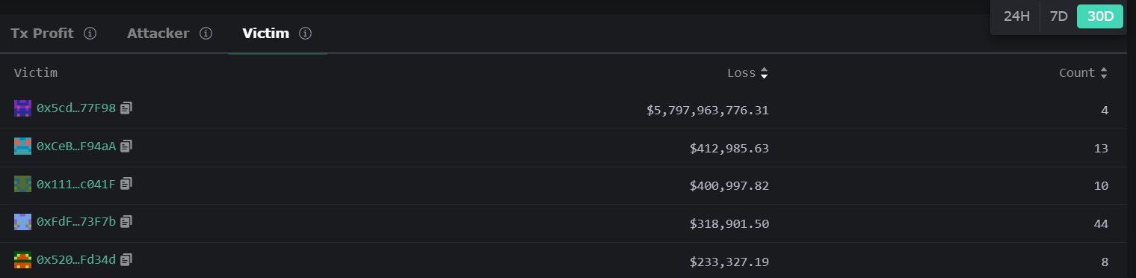
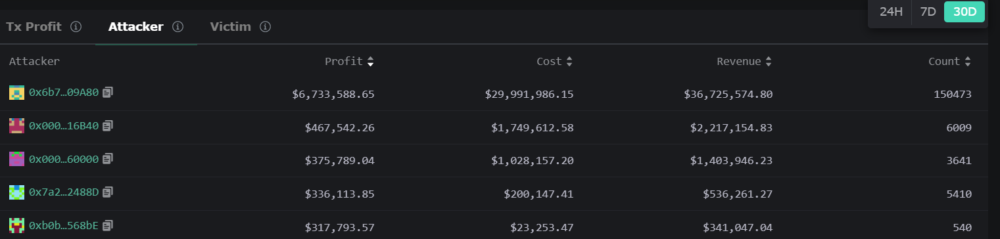
Attacks registered before 12:10 PM today
Biggest attackers and victims last 30 days

Slide 3
Sandwich attacks
Frontrunners and validators abuse their power of knowing the sequence of transaction processing.
Shuffling the order of transaction would prevent this.
But how does one know that the shuffling is truly random?
The algebraic procedure used in the script enforces a community generated random shuffling of the transaction

Slide 4
Intuition of how the program works
Users generate two numbers that the validator uses to shuffle.
Users can not front run, as it is the validator in the end that does the shuffling.
Validator can not abuse his power to shuffle like he wants, as the shuffling is subject to the algebraic constrictions by the model and numbers given by the users.
This places the user and validator in deadlock with each other if they want the transaction to be executed in a non-random order, even in a majority attack.

Slide 5
Future of this security protocol
Eliminate Sandwich attacks.
Eliminate cases where a operator can abuse his power of ordering operations to his liking.
Eliminate frontrunners from abusing putting transactions in an order that suits them but harms others.
Guarantee fairness in decentralized systems and thus make it more accessible for people with less power/less money.

